Slide 1
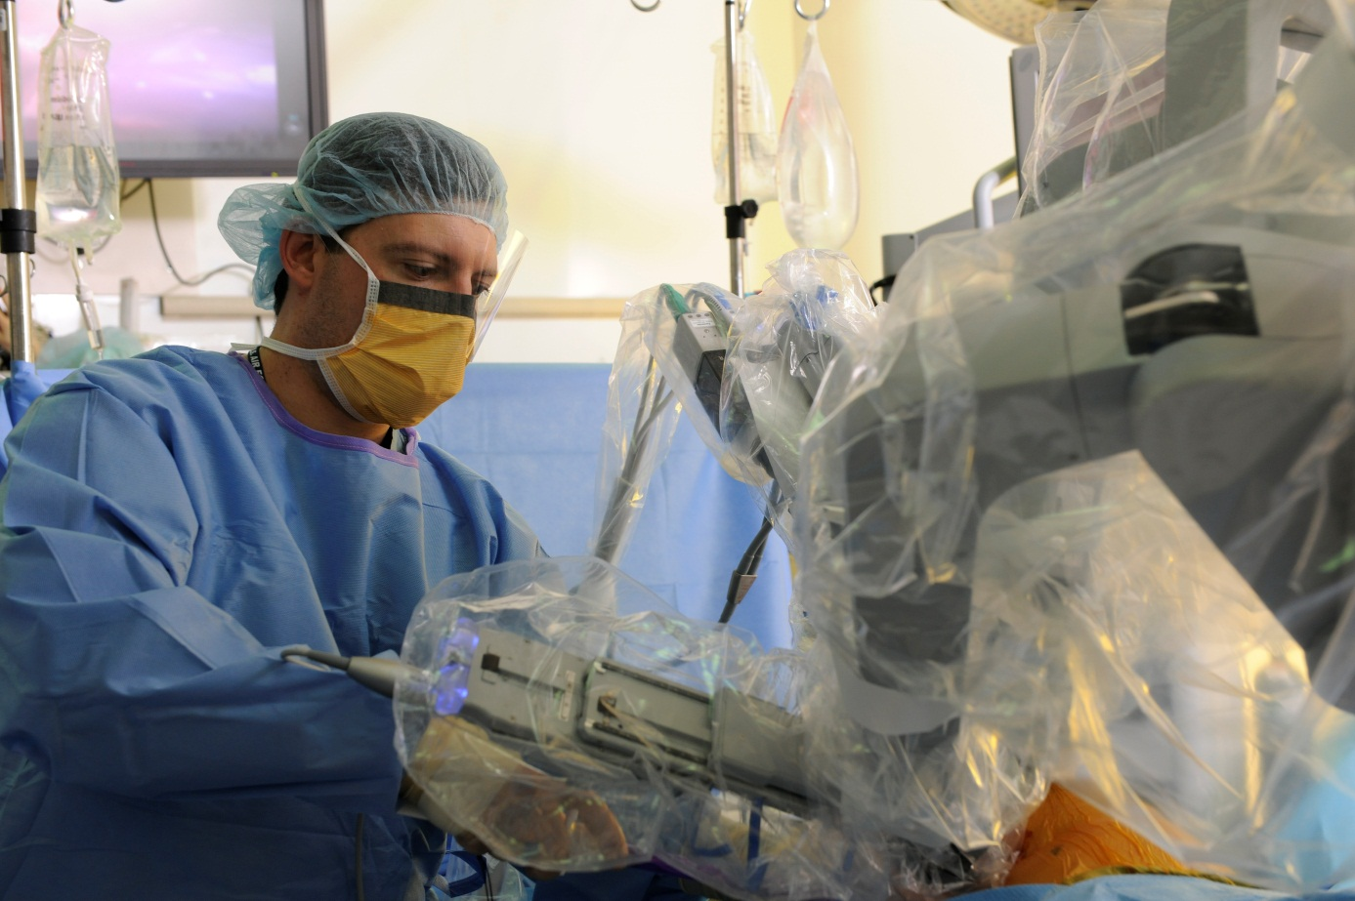
Division of Thoracic Surgery
Requests for Simmons Comprehensive Cancer Center
January 22, 2014

Slide 2
Cancer center Multidisciplinary clinic: 2011 - 2013
Thoracic Division only
(Cardiac Division cases not included)
Quarters are based on the calendar year
Data from July 2011 to December 2013
60% of patients seen by the Thoracic Division in the Cancer Center have a malignant diagnosis.
(Source EPIC chart, Last update: 1-2-14)
In 2012 there were 11 EPIC referrals from Dept 3120 (Thoracic Surgery) to Hem/Onc
In 2013 there were 26 EPIC referrals from Dept 3120 (Thoracic Surgery) to Hem/Onc

Slide 3
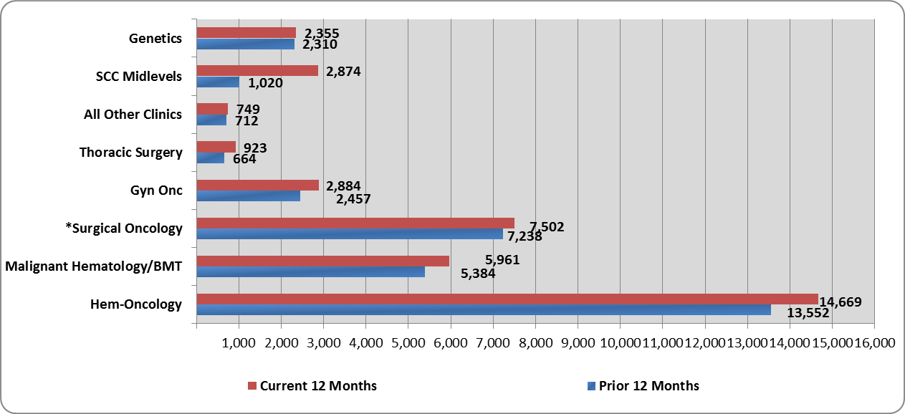
SIMMONS CANCER CENTER CLINICS- EPIC ARRIVED VISITS FOLLOW UP/ESTABLISHED VISITS: 2012 - 2013
Source: Data Warehouse as of November 2013
Received from Tim Atkinson, Sr. Financial Analyst, Simmons Cancer Center

Slide 4
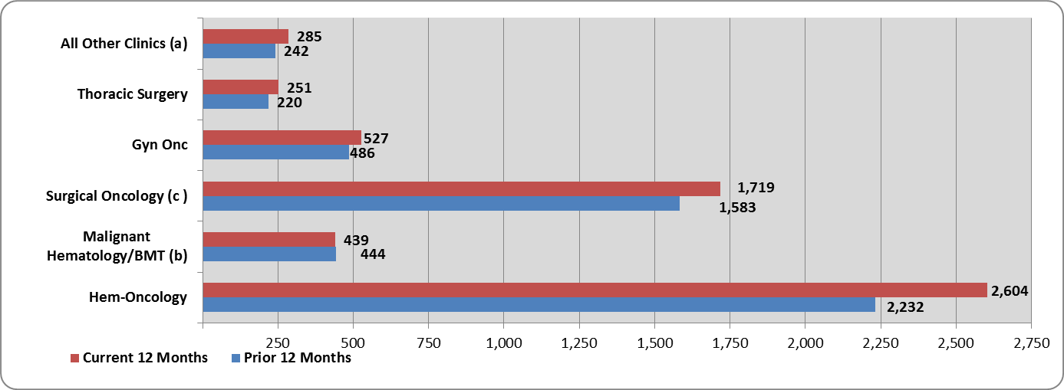
SIMMONS CANCER CENTER CLINICS- EPIC ARRIVED VISITS New Visits: 2012 - 2013
Source: Data Warehouse as of November 2013
Received from Tim Atkinson, Sr. Financial Analyst, Simmons Cancer Center

Slide 5
Surgical View: 2011 - 2013
From July 2011 to December 2013, 406 thoracic patients had surgery. 221 of those surgical patients, or 54%, had a malignant diagnosis.
Quarters are based on the calendar year
Data from July 2011 to December 2013
Data collected from EPIC charts
Thoracic patients seen in the Cancer Center
 | OR Cases | New Patients | Total # Patients seen in clinic
2011 | 99 | 126 | 220
2012 | 180 | 287 | 908
2013 | 249 | 360 | 1177
52% of referrals to the Thoracic Division result in a surgical procedure

Slide 6
Thoracic Division: 2011 - 2013
% of New patients from Outside referrals
2011 – 25%
2012 – 36%
2013 – 40%
Source: EPIC charts, updated 1-2-14

Slide 7

To Generate Chemotherapy Cases, must Generate Cases inside 30 mile radius 2011-2013
Thoracic Surgery Referrals inside 30 mile radius (2011 – 2013) | Thoracic Surgery Referrals outside 30 mile radius (2011-2013)
476 | 304
61% | 39%
Source: UTSW report run by Clarity report team on 1-9-14 based on department code.
From 2011 through 2013
Thoracic Division patient population having chemotherapy visits or chemotherapy drugs = 160
Source: UTSW report run by Clarity report team on 1-7-14 based on department codes

Slide 8
Current Market capture: 2011-2013
 | Dallas County 2006-2010 | 6 County Region* | UHSP** | UHSP % of Region
Lung and Bronchus | 5,532 (1,107/yr) | 13,421 (2,684/yr) | 225/yr | 8%
Esophageal/GE Junction | 376 (75/yr) | 894 (179/yr) | 35/yr | 20%
Data Source: Texas Department of State Health Services, Texas Cancer Registry (updated 1-20-2014) http://www.dshs.state.tx.us/tcr/data.shtm http://www.cancer-rates.info/tx/index.php
*6 County Region: Dallas, Denton, Tarrant, Ellis, Kaufman, Collin
** UTSW report run by Clarity report team on 1-8-14 based on ICD codes
Notes:
Esophageal Cancer Numbers
Invasive Cancer Incidence Rates in Dallas County, Texas Esophagus, 2006-2010 Year 2006 2007 2008 2009 2010 2006-2010 Population at Risk 2275434 2291891 2314018 2346378 2375207 11602928 Total Cases 64 76 83 71 82 376 Crude Rate 2.8 3.3 3.6 3.0 3.5 3.2 Age-Adjusted Rate 3.5 4.3 4.6 3.8 4.2 4.1 95% Confidence Interval Lower 2.7 3.4 3.6 2.9 3.3 3.7 Upper 4.5 5.4 5.7 4.8 5.3 4.5 Statewide Age-Adjusted Rate 4.2 4.2 4.2 3.8 3.9 4.1 Statewide 95% Confidence Interval Lower 3.9 3.9 3.9 3.6 3.6 3.9 Upper 4.5 4.5 4.5 4.1 4.2 4.2 Note: All rates are per 100,000. Rates are age-adjusted to the 2000 U.S. Standard Population. Data accessed January 20, 2014. Cancer Incidence File, April 2013. See Important Technical Note when using these data.

Slide 9
Billing generated from Thoracic surgery
Epic_Loc_Name | CY Roll 12 Mo Charges | PY Roll 12 Mo Charges | Var Roll 12 Mo Charges
ANESTHESIOLOGY AND PAIN MANAGEMENT | 809,494 | 665,459 | 144,035
CANCER CLINICS | 645 | - | 645
CARDIOVASCULAR & THORACIC | 1,621,671 | 1,472,200 | 149,471
DERMATOLOGY | 432 | 924 | (492)
INTERNAL MEDICINE | 264,787 | 224,489 | 40,298
MULTI-SPECIALTY | 269 | - | 269
NEUROLOGY | 4,948 | 7,279 | (2,331)
NEUROSURGERY | 274 | - | 274
OBSTETRICS AND GYNECOLOGY | 548 | - | 548
OTORHINOLARYNGOLOGY | 7,120 | 5,747 | 1,373
PATHOLOGY | 577,397 | 587,347 | (9,950)
PHYSICAL MEDICINE & REHAB | 11,883 | 7,935 | 3,948
PLASTIC SURGERY | 189 | 463 | (274)
PSYCHIATRY | 4,977 | - | 4,977
RADIATION ONCOLOGY | 146,281 | 57,659 | 88,622
RADIOLOGY | 161,101 | 110,743 | 50,358
SURGERY | 2,795 | 1,957 | 838
UROLOGY | 274 | - | 274
FAMILY MEDICINE | - | 188 | (188)
 | 3,615,085 | 3,142,280 | 472,805
Captures billing in which Thoracic Surgery was listed as the billing provider or the referring provider.
CY = Current Year (12 months = Dec 2012 through Nov 2013)
PY = Previous Year (12 months = December 2011 through Nov 2012)
VAR = Variance
Source: William Fox, Financial Manager, MSRDP Finance Administration
Data through Nov 2013

Slide 10
Billing generated from Thoracic surgery
Captures billing in which Thoracic Surgery was listed as the billing provider or the referring provider.
Adjusted_Financial_Class | CY Roll 12 Mo Charges | PY Roll 12 Mo Charges | Var Roll 12 Mo Charges
Agency | 70,834 | 35,528 | 35,306
Charity | 6,131 | 31,589 | (25,459)
Commercial | 27,976 | 7,219 | 20,757
Company Acct/Misc | 41,250 | - | 41,250
Managed Care | 1,701,811 | 1,414,818 | 286,994
Medicaid | 119,309 | 10,140 | 109,169
Medicaid Pending | - | (1,210) | 1,210
Medicare | 1,619,043 | 1,621,403 | (2,360)
Self-Pay | 28,732 | 22,794 | 5,938
 | 3,615,085 | 3,142,280 | 472,805
Source: William Fox, Financial Manager, MSRDP Finance Administration
Data through Nov 2013
CY = Current Year (12 months = Dec 2012 through Nov 2013)
PY = Previous Year (12 months = December 2011 through Nov 2012)
VAR = Variance

Slide 11
Profit from Tests ordered on thoracic patients from April to August 2012
 | New Patients | # Patients Seen in Clinic | Surgical Cases
April to August 2012 | 121 | 392 | 80
April to August 2013 | 162 | 530 | 108
Does not include in-patient tests
Types of tests/procedures | Actual Charge | Total Cost | Margin | TOTAL April 2012 | April Margins | TOTAL May 2012 | May Margins | TOTAL June 2012 | June Margins | TOTAL July 2012 | July Margins | TOTAL August 2012 | August Margins
Brain CT | $ 1,571.00 | $ 98.93 | $ 1,472.07 | 2 | $ 2,944.14 | 1 | $ 1,472.07 | 0 | $ - | 0 | $ - | 0 | $ -
Chest CT | $ 3,096.00 | $ 185.30 | $ 2,910.70 | 10 | $ 29,107.00 | 12 | $ 34,928.40 | 6 | $ 17,464.20 | 14 | $ 40,749.80 | 9 | $ 26,196.30
PET | $ 12,810.00 | $ 1,285.61 | $ 11,524.39 | 3 | $ 34,573.17 | 3 | $ 34,573.17 | 5 | $ 57,621.95 | 1 | $ 11,524.39 | 4 | $ 46,097.56
MRI - brain | $ 5,193.00 | $ 413.25 | $ 4,779.75 | 2 | $ 9,559.50 | 2 | $ 9,559.50 | 5 | $ 23,898.75 | 4 | $ 19,119.00 | 2 | $ 9,559.50
PFTs/ DLCS/ ABGs | $ 244.00 | $ 21.80 | $ 222.20 | 14 | $ 3,110.80 | 12 | $ 2,666.40 | 9 | $ 1,999.80 | 8 | $ 1,777.60 | 8 | $ 1,777.60
Esophageal Motility Swallow/Oral Eval | $ 286.00 | $ 96.46 | $ 189.54 | 1 | $ 189.54 | 0 | $ - | 0 | $ - | 0 | $ - | 1 | $ 189.54
Swallowing Studies | $ 480.00 | $ 73.48 | $ 406.52 | 1 | $ 406.52 | 0 | $ - | 4 | $ 1,626.08 | 0 | $ - | 1 | $ 406.52
CXR | $ 436.00 | $ 78.84 | $ 357.16 | 37 | $ 13,214.92 | 35 | $ 12,500.60 | 46 | $ 16,429.36 | 27 | $ 9,643.32 | 33 | $ 11,786.28
Lab | $38 to $763 |  |  | 27 |  | 17 |  | 17 |  | 10 |  | 25
EKG/ Stress/ Echo | $ 27.00 | $ 32.65 | $ (5.65) | 9 | $ (50.85) | 11 | $ (62.15) | 15 | $ (84.75) | 2 | $ (11.30) | 17 | $ (96.05)
CT Guided Needle Biopsy | $ 1,773.00 | $ 556.03 | $ 1,216.97 | 1 | $ 1,216.97 | 0 | $ - | 3 | $ 3,650.91 | 3 | $ 3,650.91 | 1 | $ 1,216.97
Ultrasound | $ 569.00 | $ 297.51 | $ 271.49 | 1 | $ 271.49 | 0 | $ - | 2 | $ 542.98 | 2 | $ 542.98 | 1 | $ 271.49
 |  |  |  |  | $ 94,543.20 |  | $ 95,637.99 |  | $ 123,149.28 |  | $ 86,996.70 |  | $ 97,405.71
Data Source: from the UTSW office of the Director of Decision Support and Chargemaster Maintenance
Collection date: 2012

Slide 12
Comparison of workload benign vs malignant
Getting list from Linda and Leah

Slide 13
Patient Volumes
 | Avg per month | 2013 Volume | 2013 % increase | Comments
Clinic Volume | 2012: 76 per month 2013: 98 per month | 1177 | 30% | Available clinic rooms: 2
New patient volume | 2012: 24 per month 2013: 30 per month | 359 | 25%
Surgical Volume | 2012: 15 per month 2013: 21 per month | 249 | 38%
 | 2014 est Avg per month | 2014 Expected volume with 1 surgeon - same rate of increase | 2015 Expected volume with 1 surgeon - same rate of increase
Clinic Volume | 127 | 1528 | 1971 | Need 4 clinic rooms, 2 days a week
New patient volume | 38 | 450 | 563 | Need 1 clinic room, 3 days a week
Surgical Volume | 28 | 341 | 466

Slide 14
Personnel Requirements
Position Requested | 2011-2013 | 2014 | 2015
RN Nurse Navigator | 1 FTE (provided by SCCC) | 2nd FTE - March 2014 Add 3rd FTE 3 mo. after hire of 2nd surgeon | 4th FTE - June 2015
MOA - CSA | 1 FTE | 2nd FTE - June 2014 (once 2nd surgeon hired) | 3rd FTE - Jan 2015 after 3rd surgeon hired
Will add more information on MOA and RN here.

Slide 15
Goals, Strategies, actions
Goals | Strategy | Actions
Increase # patients to SCCC | Available | See patients as they request (ASAP)
Increase market capture | Assessable | Respond to Calls (Decisions)
Decrease Cost of Care | Amiable | Prepare for Surgery
Prevent Readmissions | Adaptable | Follow induction patients
 | Able | Prepare patients for clinic (data acquisitions)
 |  | ID patients co-morbidities (treat and control them)
 |  | Recover from surgery (DAD calls)
 |  | Initiate & Complete EPIC
 |  | Deal with institutional inertia
 |  | See patients frequently post-op

Slide 16
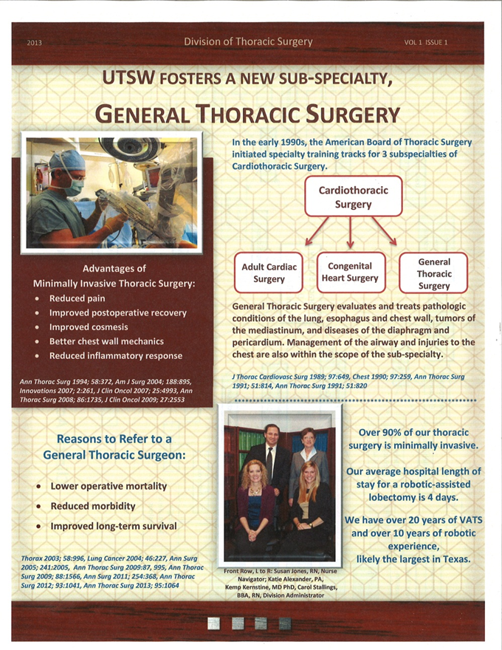
Marketing efforts
UTSCAPS
Local and Office Presentations
Thoracic symposia
Mailing List Development—750 and rising
Communication with referring physicians
All clinic notes, OR notes, D/C Summaries
Mailings to include information on our department and EBM articles
Newsletters
Local/Regional/National/International presentations/publications

Slide 17
Thoracic Surgical Cases: 2009-2013
- Data gathered from Thoracic STS Database
* VA counts based on OR schedule, not complete through month of Dec 2013

Slide 18
SPUH Lung Resections By Type
2009 - 2013

Slide 19
SPUH Lung Resections: Robotic vs. VATS vs. Open
2009 – 2013
 | 2009 | 2010 | 2011 | 2012 | 2013
Robotic | 0 | 5 | 21 | 43 | 41
VATS | 16 | 26 | 29 | 45 | 28
Open | 43 | 39 | 25 | 28 | 19
Total Lung Resections | 59 | 70 | 75 | 116 | 88
Notes:
STS definition of lung resection: pneumo, bilobe, lob, segment, wedges. NO wedge biopsies.

Slide 20
SPUH Lung Resections: Average LOS, Surg Date – D/C Date
2009 - 2013
 | 2009 | 2010 | 2011 | 2012 | 2013
Avg LOS | 9 | 7 | 6 | 5 | 4
Surg through D/C
Robotic | - | 9 | 4 | 5 | 4
VATS | 8 | 5 | 4 | 4 | 3
Open | 9 | 9 | 10 | 9 | 6
Pneumonectomy | 7 | 7 | 7 | 7 | 6
Lobe/Bilobe/ | 9 | 8 | 6 | 6 | 4
Segmentectomies
Wedges / LVRS | 8 | 7 | 5 | 5 | 3
Note:
Outliers not included in average LOS, using 2 standard deviations from the mean

Slide 21
SPUH Esophagectomies
2006 – 2013

Slide 22
SPUH Esophagectomies
2006 – 2013
 | 2006 | 2007 | 2008 | 2009 | 2010 | 2011 | 2012 | 2013*
Avg LOS (days) | 28 | 19 | 24 | 37 | 23 | 17 | 17 | 23
Surg through D/C
Robotic | - | - | - | - | - | 8 | 13 | 25
Open | 28 | 19 | 24 | 40 | 23 | 21 | 21 | 18
Note: 1 robotic esophagectomies not factored into LOS, current inpatient
 | 2006 | 2007 | 2008 | 2009 | 2010 | 2011 | 2012 | 2013
# Esophagectomies | 12 | 11 | 14 | 11 | 7 | 7 | 4 | 9
# Operative Mortalities | 1 | 0 | 0 | 0 | 0 | 1 | 1 | 0
Operative Mortality Rate | 8% | 0% | 0% | 0% | 0% | 14% | 25% | 0%
# w/ Anastomotic Leak | 2 | 0 | 1 | 2 | 2 | 1 | 1 | 4
% w/ Anastomotic Leak | 17% | 0% | 7% | 20% | 29% | 14% | 25% | 44%
# w/ Unexpected Return to OR | - | - | - | 8 | 1 | 1 | 1 | 2
%w/ Unexpected Return to OR | - | - | - | 80% | 14% | 14% | 25% | 22%
No data available

Slide 23
SPUH Thymectomies
2009 - 2013
 | 2009 | 2010 | 2011 | 2012 | 2013
Average LOS Surg through D/C | 3 | 2 | 3 | 2 | 3
Min Invasive LOS | - | 1 | 2 | 3 | 3
Open LOS | 3 | 3 | 4 | 1 | 2

Slide 24
Breakdown by Major Procedure as entered in STS database
2009 – 2013
Major Procedures, % of all STS Surgeries
 | 2009 | 2010 | 2011 | 2012 | 2013
Endoscopies | 43% | 42% | 32% | 31% | 37%
Lung Resections | 14% | 16% | 17% | 22% | 20%
Lung & Pleural, non-resections | 13% | 14% | 16% | 15% | 15%
Mediastinal Procedures | 12% | 10% | 17% | 16% | 10%
Thymectomies | 1% | 2% | 2% | 2% | 4%
Chest Wall/Neck | 2% | 4% | 3% | 3% | 4%
Esophag Proc, non-resections | 3% | 3% | 2% | 3% | 3%
Esophageal Resections | 3% | 2% | 1% | 1% | 2%
Pericardial Windows | 3% | 2% | 3% | 2% | 1%
Trach/Bronch, non-endoscopy | 4% | 4% | 3% | 2% | 1%
Sympathectomies | 0% | 1% | 0% | 1% | 1%
Miscellaneous | 3% | 1% | 2% | 1% | 2%

Slide 25


Slide 26
We must offer something different to change referral patterns?
Efficient Care
Detailed Review of patient management and care
Unique surgery
Better Outcomes
Educate-In-depth review and recommendations—Guidelines, Literature Review, Tumor Board
Clinical trials

